Slide 1
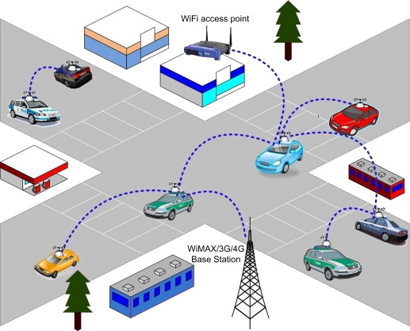
Vehicular Ad hoc Network(VANET)
Nirojan – 300807665
Syed – 301318212
Deepak - 301304684

Slide 2
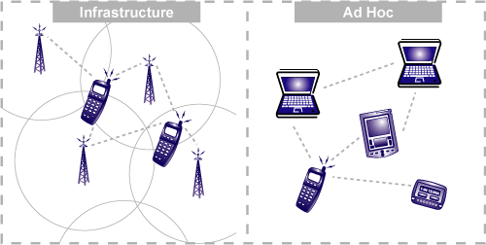
What is VANET ?
Definition and Purpose:
Vehicular Ad-Hoc Networks (VANETs) are dynamic networks formed by interconnected vehicles and infrastructure-less communication devices, enabling real-time communication.
Purpose: VANETs facilitate the exchange of critical information among vehicles and infrastructure, enhancing road safety, traffic management, and overall transportation efficiency.
Role in Modern Transportation Systems:
VANETs play a pivotal role in the transformation of transportation systems by leveraging mobile communication technologies.
Dynamic and Adaptable Nature:
Highlight the dynamic nature of VANETs, where vehicles can freely join or leave the network as they move, allowing for adaptable communication.
Enhanced Safety and Communication:
Emphasize how VANETs enable vehicles to exchange real-time information, contributing to accident prevention, hazard warnings, and overall road safety.

Slide 3

Importance of VANET
Content:
Elevating Road Safety: VANETs facilitate real-time communication for hazard alerts and accident prevention.
Optimizing Traffic Dynamics: Enhance traffic flow and congestion management.
Swift Emergency Response: Faster communication for efficient emergency services.
Environmental Sustainability: Contribution towards reducing fuel consumption and emissions.
Pioneering ITS: Integration of technology for safety and efficiency.
Shaping Future Mobility: VANETs contribution to the progression of autonomous vehicles and smart cities.

Slide 4
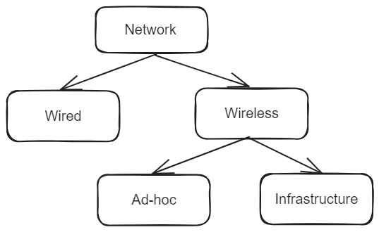
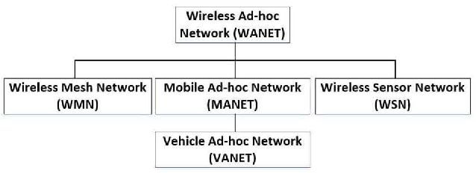
Background Context
1. Wired networks use cables for stability, while wireless networks like WLANs offer mobility through radio waves.
2. Wireless Ad-hoc Networks (WANETs) enable direct device communication, suitable for scenarios without fixed infrastructure, such as emergencies.
3. The shift to wireless ad-hoc networks, like WANETs, reflects a dynamic, adaptable communication approach, emphasizing mobility and decentralized connectivity in changing environments.
4. Vehicle Ad-hoc Networks (VANETs), a type of Mobile Ad-hoc Network (MANET), enhance traffic efficiency, detect road conditions, reduce collisions, and improve overall network efficiency through dynamic, sensor-equipped communication.

Slide 5
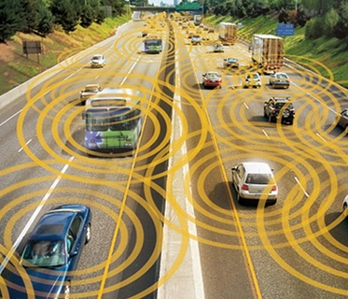
Communication Architecture in VANET
Vehicular Ad-hoc Networks (VANET) architecture aligns with IEEE 1471-2000 and ISO/IEC 42010 guidelines, categorizing entities into three domains: Mobile (vehicles and portable devices), Infrastructure (roadside and central infrastructure), and Generic (Internet and Private infrastructure).
Data flows from the mobile domain to infrastructure, optimizing road utilization.
VANET communication involves In Vehicle Communication for monitoring vehicle systems, Vehicle-to-Vehicle (V2V) for exchanging warnings and information, Vehicle-to-Road Infrastructure (V2I) for updates from roadside infrastructure, and Vehicle-to-Broadband Cloud (V2B) for broadband-enhanced communication, aiding driver assistance and tracking.

Slide 6

Applications in VANET
Safety Applications:
Information Messages: Details about work zones, toll collection points, and speed limits to provide crucial information for highway driving.
Warning Messages: Alerts about upcoming traffic signals, toll points, or adverse road conditions to enhance driver awareness and road safety.
Comfort Applications:
Navigation: Provides navigation services for efficient route planning and guidance during travel.
Entertainment: Allows passengers to enjoy real-time audio and video entertainment within the vehicle, enhancing the travel experience.

Slide 7
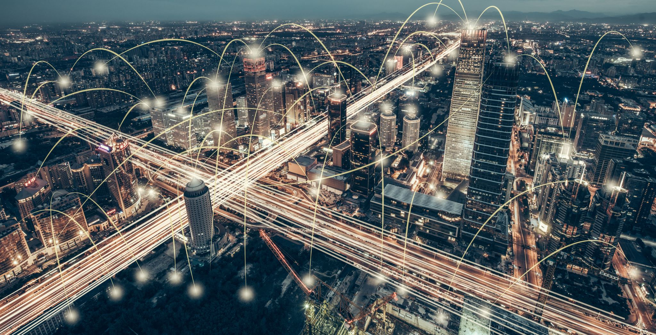
Security Concerns in VANET
Pseudonymity
Privacy
Scalability
Mobility
Data Verification
Security Challenges:
Availability
Authentication
Integrity
Confidentiality
Nonrepudiation

Slide 8

Challenges & Future Research Directions
1. VANET faces challenges in developing advanced network models to accommodate the dynamic movement of highly mobile vehicles.
2. Efficiently managing and storing vast data generated by VANETs requires ongoing research on integrating Big Data technologies.
3. VANET's open nature raises security concerns, necessitating robust models for data integrity and addressing privacy threats from untrustworthy nodes.
4. Achieving consistent, high-quality service delivery in VANETs is hindered by the dynamic environment, requiring research on mechanisms to adapt to variations in node position, topology, and connectivity.

Slide 9


Attacks
Examples of Attacks:
Eavesdropping Assault
Denial of Service Assault
Jamming Assault
Sybil Assault
Node Impersonation Assault
GPS Spoofing Assault
Brute Force Assault
Notes:
Impact of Attacks:
Compromise of Integrity, Confidentiality, Authenticity:
Attacker's actions lead to compromised data trust and reliability.
Disruption of Network Operations:
Attacks hinder communication and affect VANET functionalities.
Threats to Privacy and Safety:
Eavesdropping and tampering compromise user privacy and potentially endanger road safety.
Countermeasures:
Discuss Potential Countermeasures:
Encryption methods, authentication protocols, intrusion detection systems.
Highlight the importance of robust security mechanisms to mitigate these threats in VANETs.

Slide 10

Recommendations
Integration of Big Data Technologies
Collaboration for Standardization
User Privacy Preservation Techniques
Application of Artificial Intelligence (AI)
User Education and Awareness Programs

Slide 11
Conclusion
Summary: Recap the key points covered throughout the presentation, including the significance of VANETs, their role in enhancing road safety, optimizing traffic, and providing various applications for convenience and efficiency.
Emphasis on Security Challenges: Reiterate the critical challenges faced by VANETs, especially concerning security, and how these challenges can impact the network's integrity, confidentiality, and reliability.
Importance of Solutions: Stress the necessity of addressing these challenges and implementing robust solutions discussed earlier, emphasizing the potential solutions for enhancing VANET security.
Future Outlook: Discuss the potential future developments in VANET research and the ongoing need for advancements in technology, protocols, and security mechanisms to ensure a safer and more efficient transportation system.
Call to Action: Encourage continued research, collaboration among academia, industry, and policymakers, and the adoption of innovative solutions to overcome the challenges and pave the way for the evolution of secure and reliable VANETs.

Slide 12

Thank You

